Slide 1
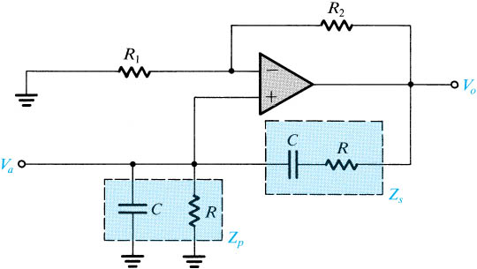
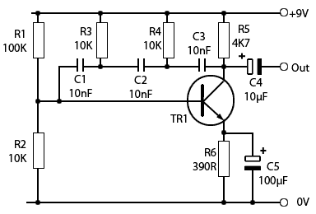
Quiz 8
Deadline: June 19, 2020
Question 1
Design the Wien bridge oscillator in Fig. 1 at f_{o} = 10 kHz, R = 4.7k and R₁ = 2.2k. In practice, R₂ is replaced by a potentiometer, explain why?
Fig. 1
Question 2
What is the name of the oscillator described in in Fig. 2?
Compute frequency of oscillation.
What is the condition of the transistor to give the oscillation?
Fig. 2

Slide 2
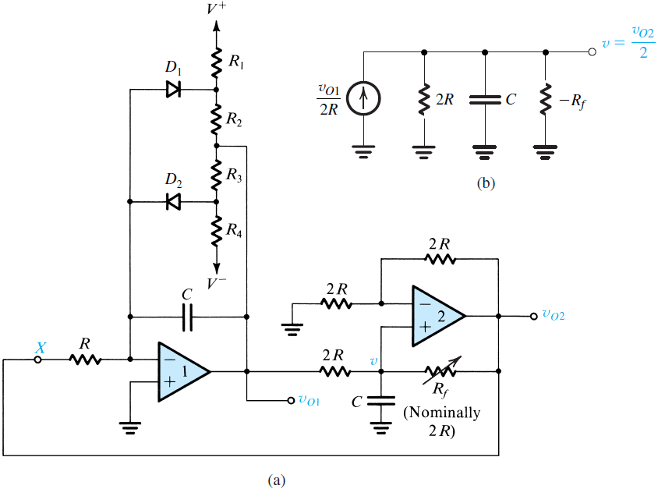
Question 3
Given C = 0.01μF, R₁ = R₄ = 3k, R₂ = R₃ =1k, V⁺ = 15V, V⁻ = -15V in Fig. 3.
a. Design the oscillator with frequency of oscillation f_{o} = 10 kHz.?
b. Determine v_{o1} if D₁ conducts.
c. What is the advantage of the circuit in Fig. 3.
Fig. 3

